Slide 1
Bristol Aquarium
Acorns Class
Years R,1,2
March 3rd 2020

Slide 2
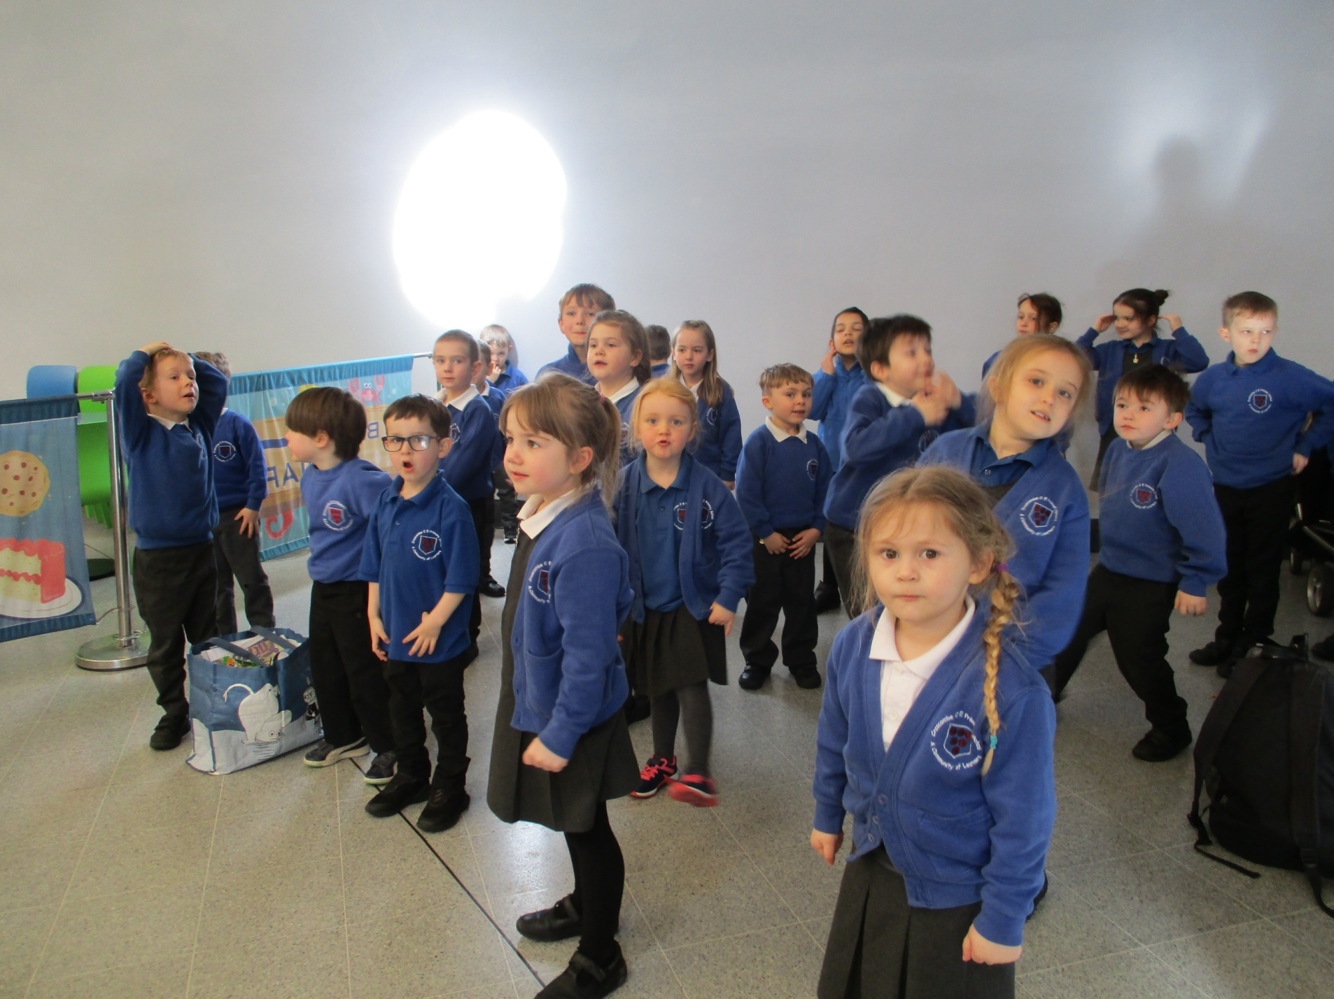

Slide 3
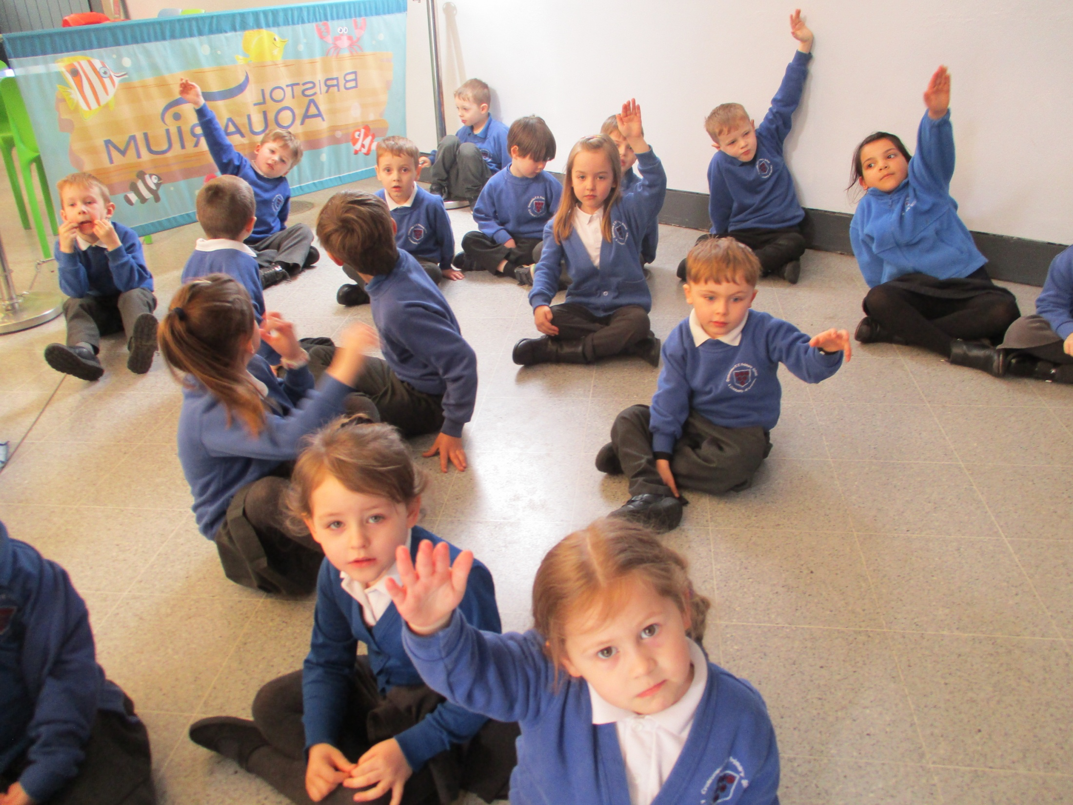

Slide 4
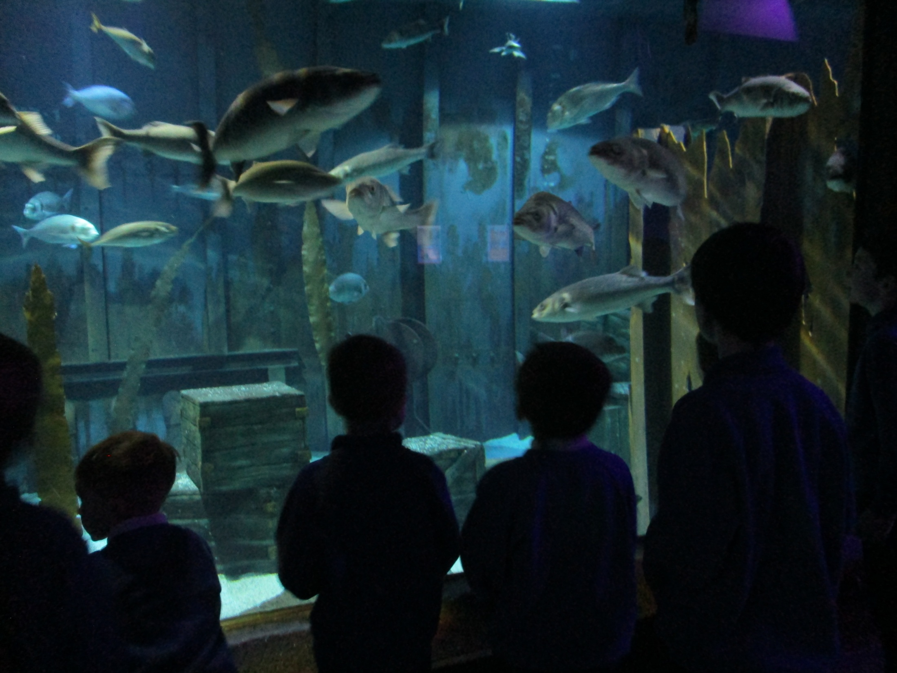

Slide 5
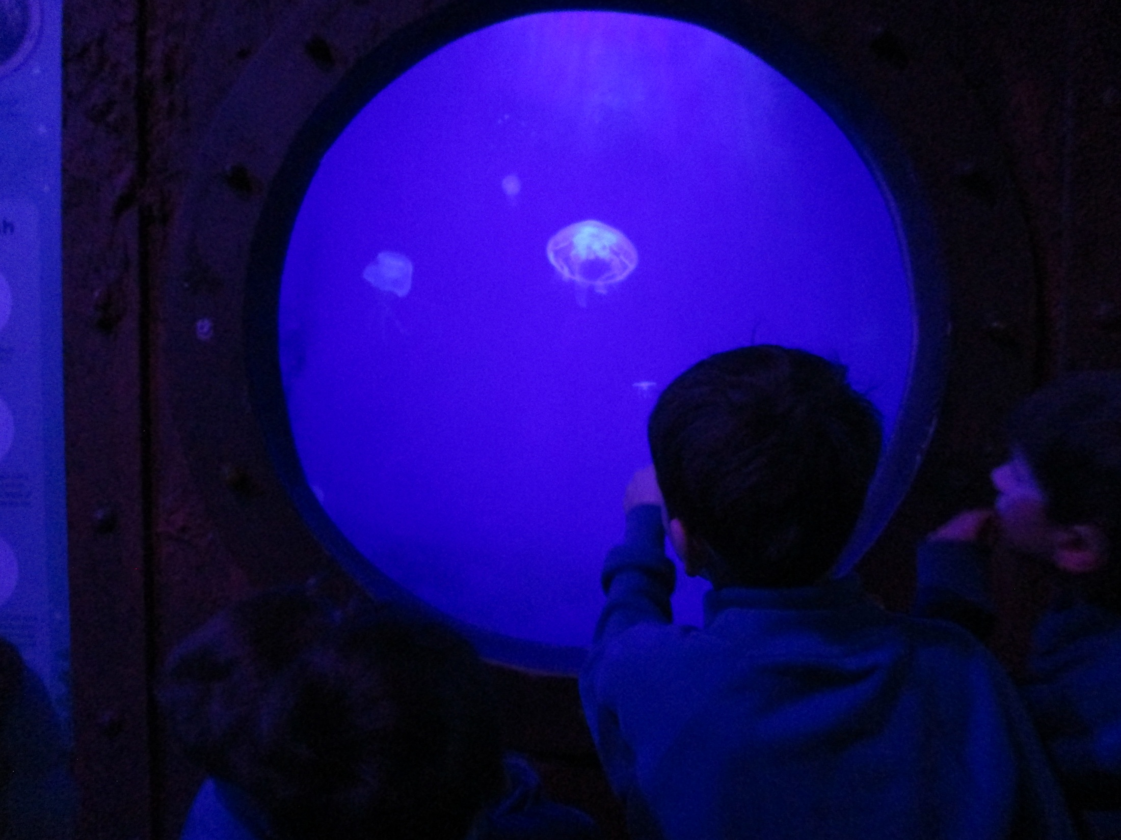

Slide 7
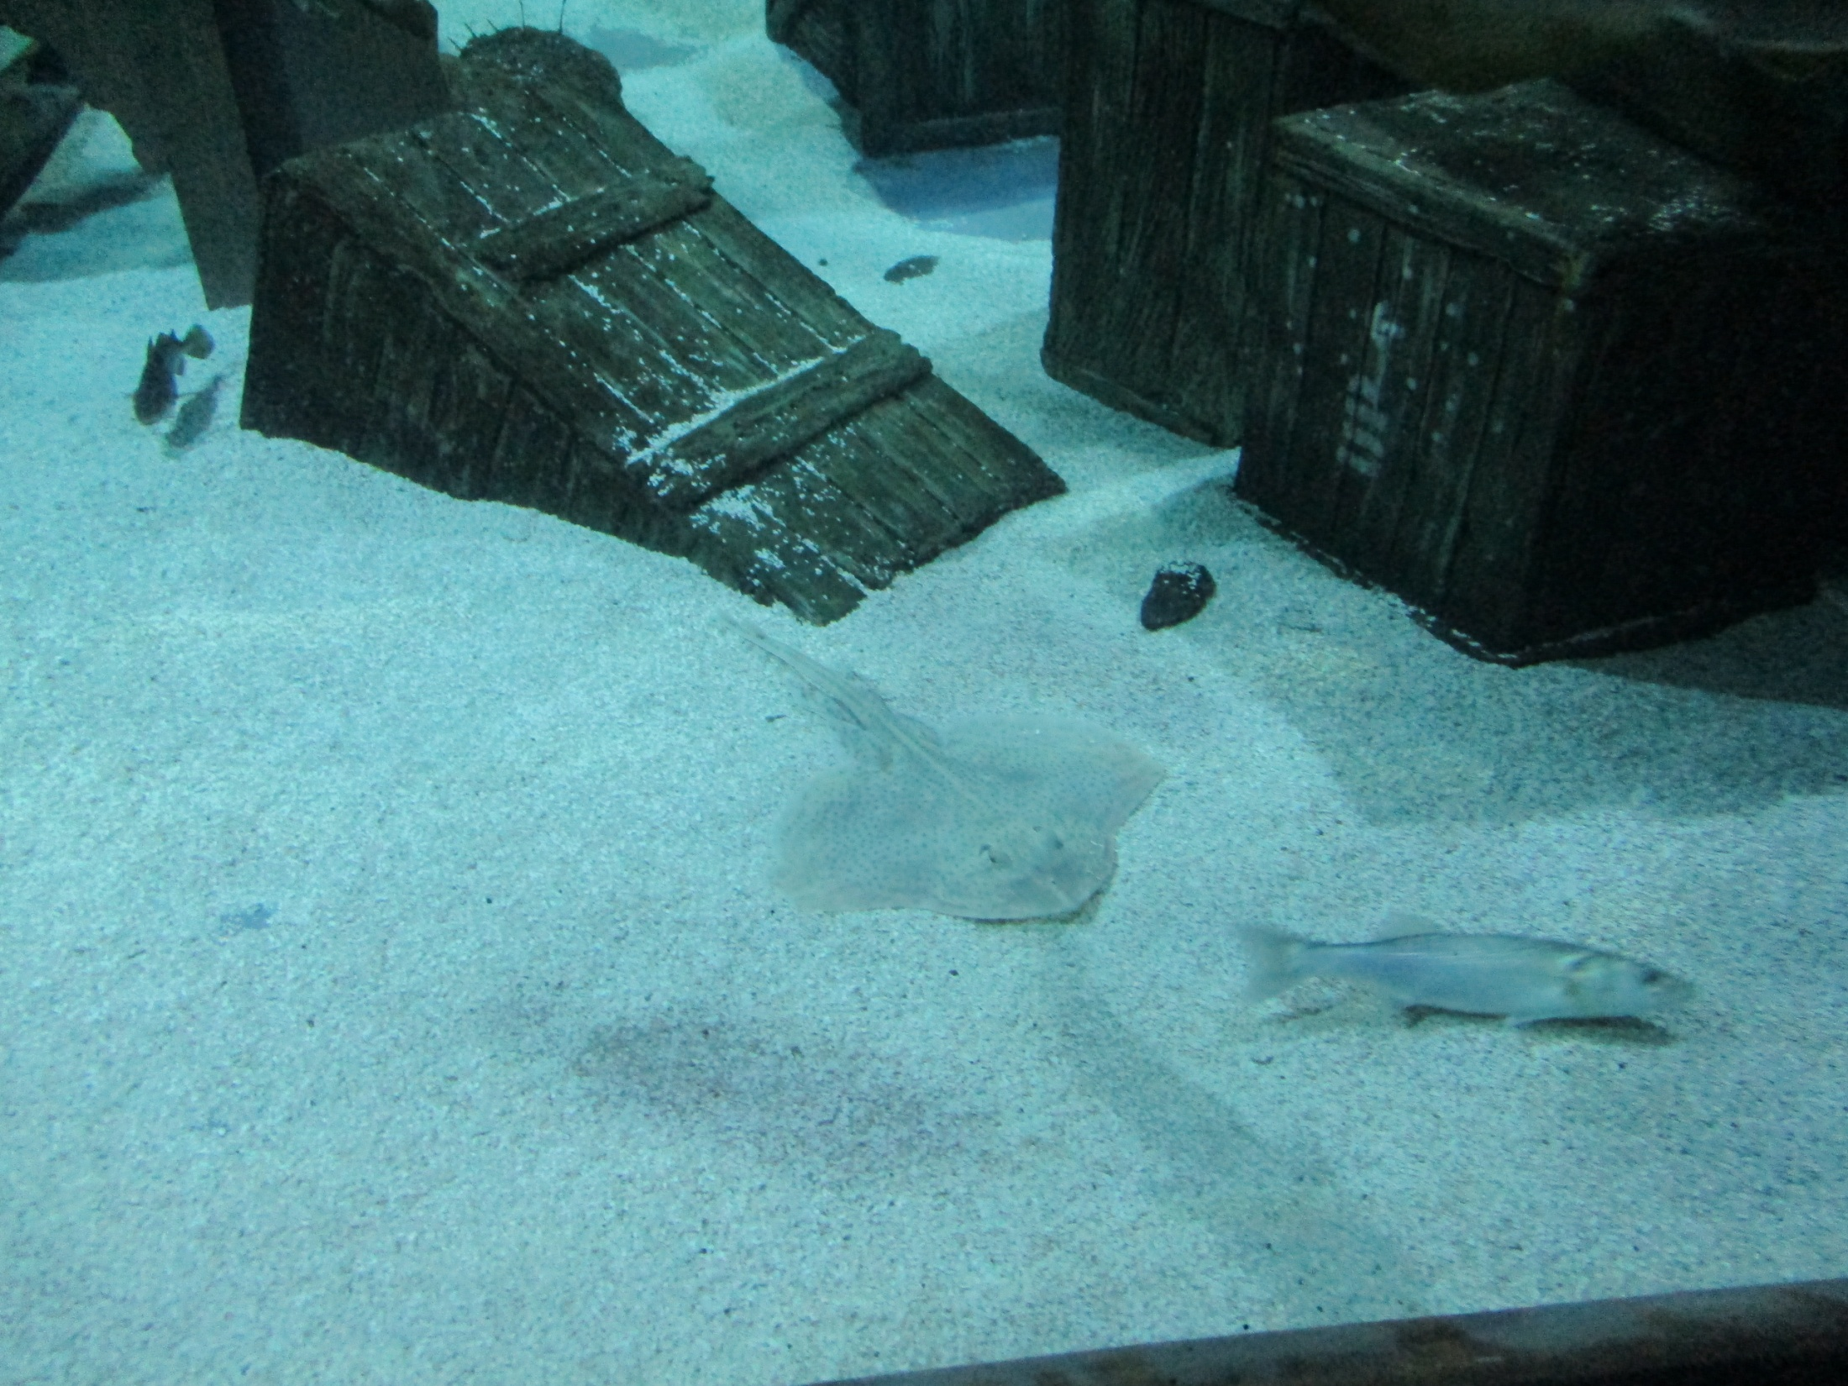

Slide 8
